Slide 1

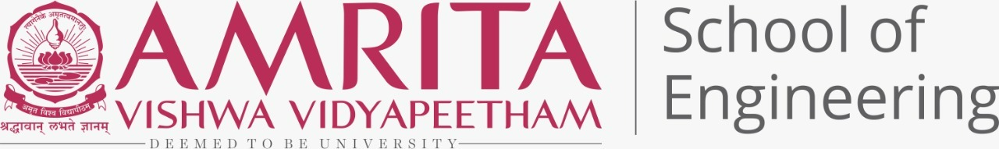
AI IN CANCER
Karthik g Nair - am.en.u4aie21138
Vishnu Shaji – am.en.u4aie21167
R Aravind – am.en.u4aie21151
Mamidi Sowji Krishna – am.en.u4aie21181
Akhilesh – am.en.u4aie21108

Slide 2
INTRODUCTION
Artificial intelligence (AI) and machine learning (ML) are gradually strengthening their impact in everyday life and are believed to have a dominant influence in digital health care for disease diagnosis and treatment in near future.
Technological advancements in AI and ML have paved the path towards autonomous disease diagnosis tools by utilizing big data sets to meet the future challenges for human disease detection at a very early stage specially in cancer.
DL can process data including medical images by Artificial neural network (ANN) to mimic the human neural architecture and is composed of input, output, and various hidden multi-layer networks to enhance machine learning processing powers.

Slide 3
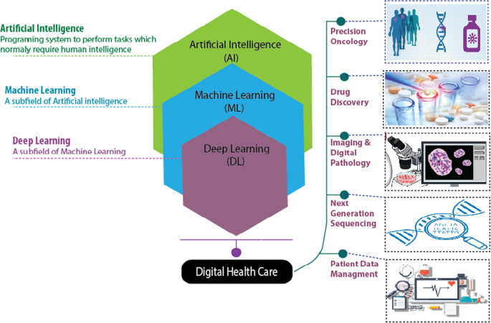

Slide 4
CONTINUED
AI is growing by leaps and bounds. Research on clinical oncology is now more focused to decode the molecular onset of cancer by understanding the complex biological architecture of cancer cell proliferation.
Moreover, the use of AI in clinical decision-making is believed to increase the chances of early disease prediction and diagnosis by NGS(Next Generation Sequencing (genomics)) sequencing and high-resolution imaging techniques.
It would also lead to introduce novel biomarkers for cancer diagnosis, designing novel personalized drugs, and delivery of potential treatment strategies by generating significant datasets and using specialized bioinformatic tools.

Slide 5
AI IN CANCER IMAGING
AI based algorithm is now-a-days used in cancer imaging to get better results in imaging process. Artificial intelligence tools can be conceptualized to apply to 3 broad categories of image-based clinical tasks in oncology:
1) Detection of abnormalities
2) Characterization of a suspected lesion by defining its shape or volume, histopathologic diagnosis, stage of disease, or molecular profile
3) Determination of prognosis or response to treatment over time during monitoring.

Slide 6
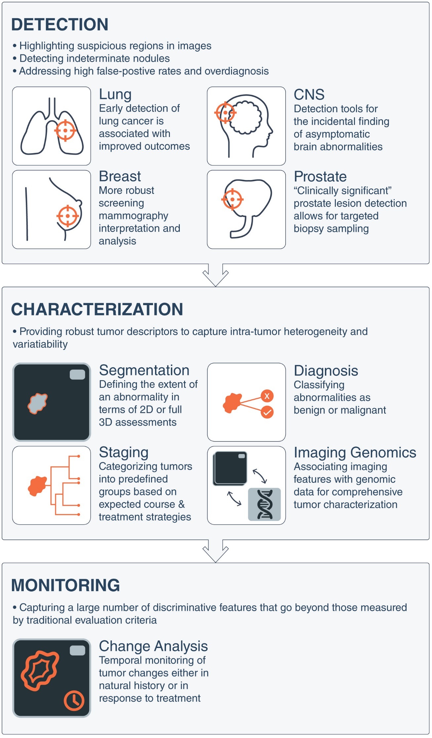

Slide 9
AI IN CANCER TREATMENT
AI and anticancer drug development:
AI can be used to predict anticancer drug activity or assist in anticancer drug development. Different cancers and the same drugs may have different reaction modes, and data from high-throughput screening procedures often reveal the relationship between genomic variability of cancer cells and drug activity.
AI and chemotherapy:
In the field of cancer chemotherapy, AI focuses more on the response between drugs and patients. The main application achievements of AI include management of chemotherapy drug use, prediction of chemotherapy drug tolerance and optimization of chemotherapy program. AI can perfect and accelerate the optimization process of combined chemotherapy.

Slide 10
CONTINUED
AI and radiotherapy:
In the course of cancer radiotherapy, the application of AI technology is more specific. AI can help radiologists map out target areas or automatically plan radiation regimens for treatment . Researchers used the three-dimensional convolutional neural network (3D CNN) to achieve automatic delineation of nasopharyngeal carcinoma, with an accuracy of 79%, which is comparable to that of radiotherapy specialists.
AI reduces cancer overtreatment:
Researchers developed an algorithm that can analyse the digital images of women's cervix and accurately identify the precancerous lesions that need to be treated, so as to reduce the overtreatment of patients. There is a machine learning tool that can reduce the excessive treatment of lesions suspected of breast cancer.

Slide 11
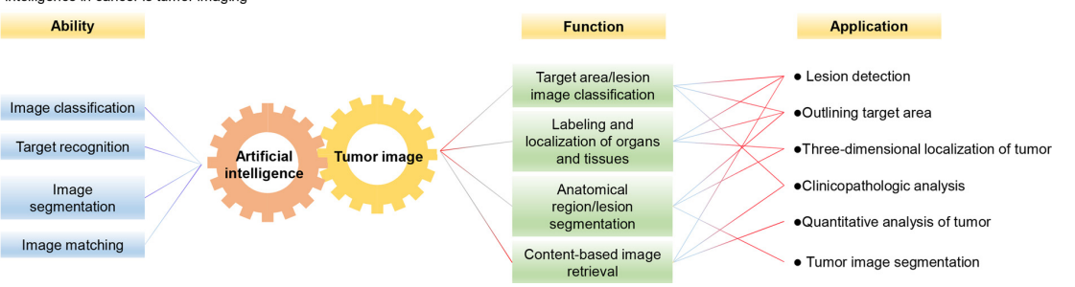

Slide 12
OUR IDEAS
Increased cancer detection centers at reduced cost by using Artificial Intelligence.
Making nano robots that can go through our blood and destroy cancer cells, thus increasing precision and efficiency of treatment. Also, it can be used for placing medicine at correct spots. Also placing a nano robot in the body that can scan and monitor a cancer patient’s progress.

Slide 13
CONTINUED
Cancers are caused by damage to the DNA in your cells. So, we can use some technique to restore our DNA structure.
Developing smart device at affordable price that can monitor for cancer cells in the body.

Slide 14
CONCLUSION
Humans are limited by their own level of knowledge, making it difficult to formulate the most appropriate treatment for cancer and detection at ease. If doctors choose inappropriate treatment or can’t identify cancer early, patients will miss key treatment opportunities, and even delay the patient's condition. AI can provide important insights and information that cannot be found by human identification and personalize treatment for each cancer patient . AI could speed up the discovery of new materials, a move that could dramatically accelerate the development of anticancer drugs. It is believed that AI will be a powerful driving force for human cancer research and treatment in the future. We believe that AI will bring profound changes to medical technology in the future.

